Slide 1
E-PROJECT:
Alpine Ascents
DEVELOPER GUIDE

Slide 2
Project Group members:​
Students Name​ | Students Id​
Burhan Mustafa | Student1729324
Abdullah Memon
M. Moiz
FACULTY NAME: Sir.Maaz Rahim​
Co-ordinator NAME: Ashna Nasir

Slide 3
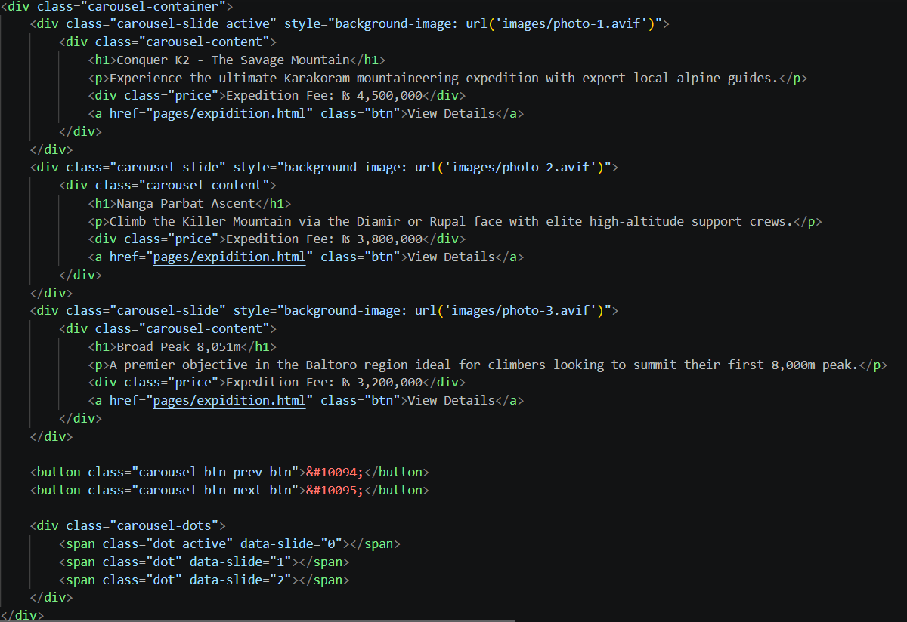
INDEX PAGE
The main entry point that serves as the homepage, guiding users to key sections.

Slide 4
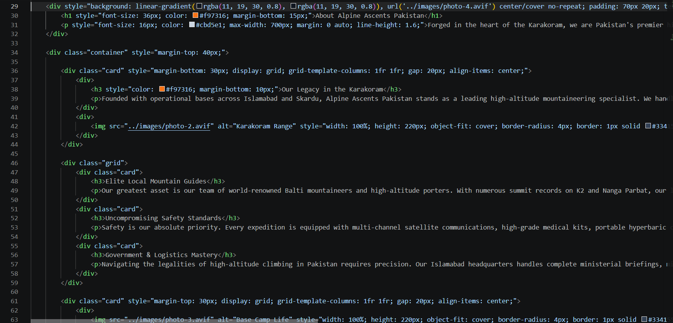
About PAGE
Provide info about our company

Slide 5
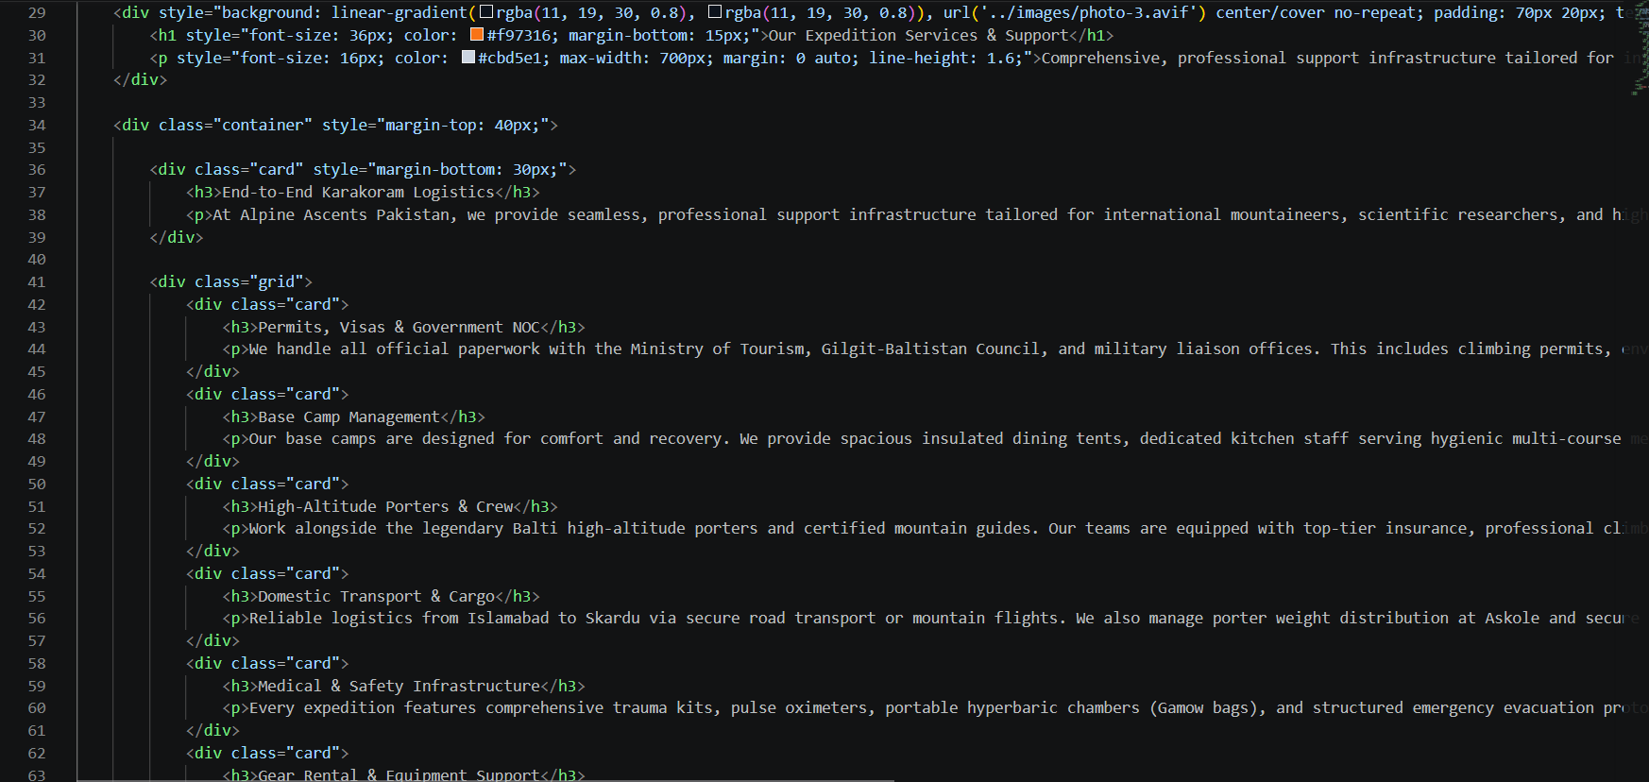
Services PAGE
Provides info about our services

Slide 6
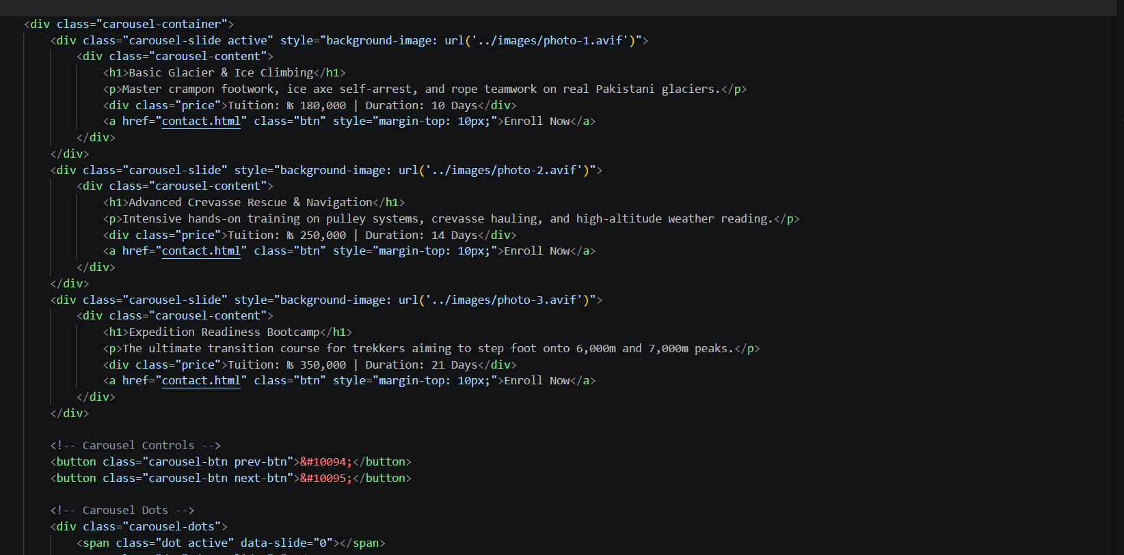
School Page
Showcases our school and knowledge

Slide 7
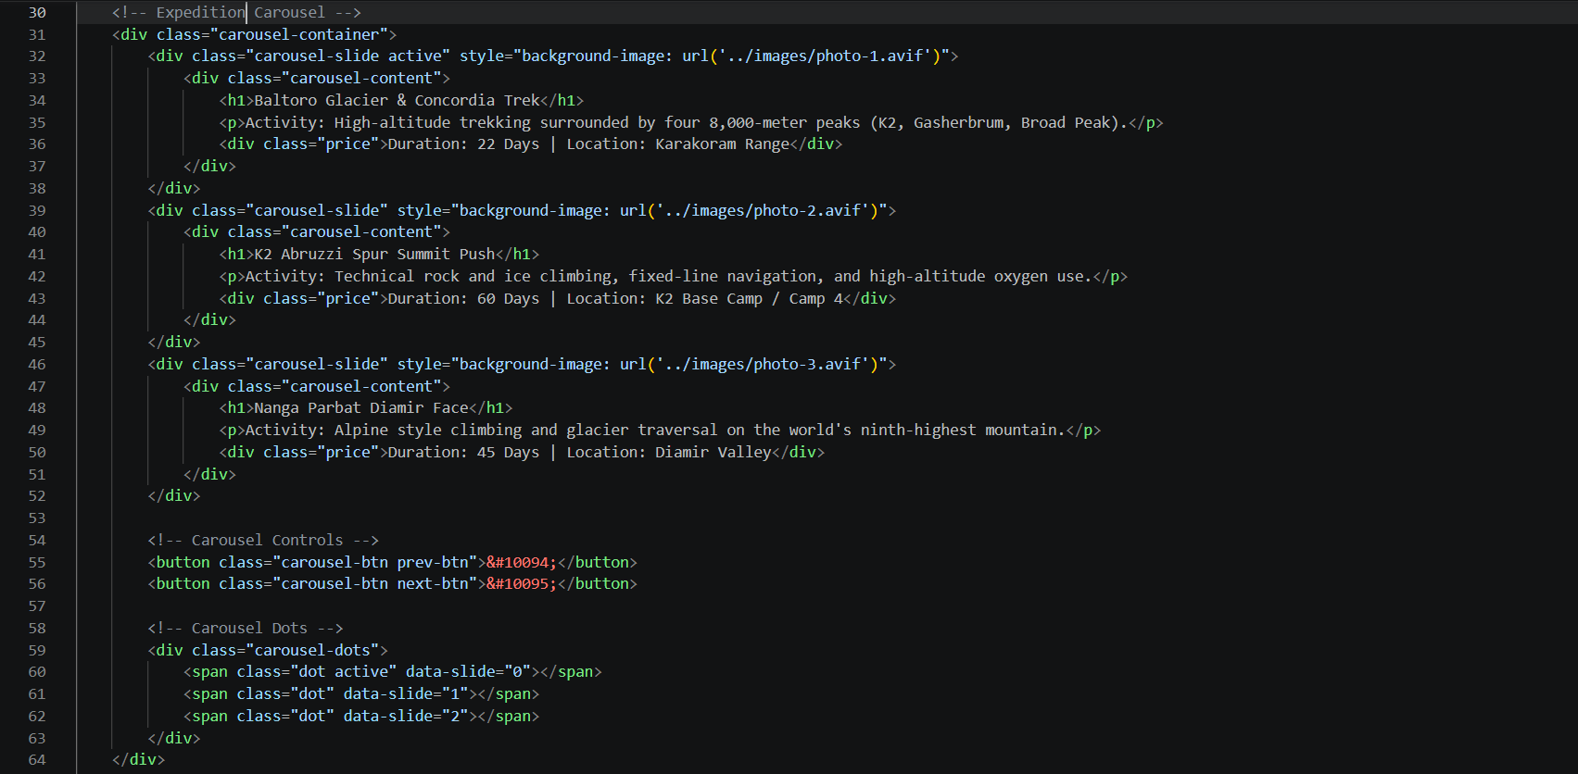
Expeditions Page
Telling Clients about Upcoming Expeditions

Slide 8
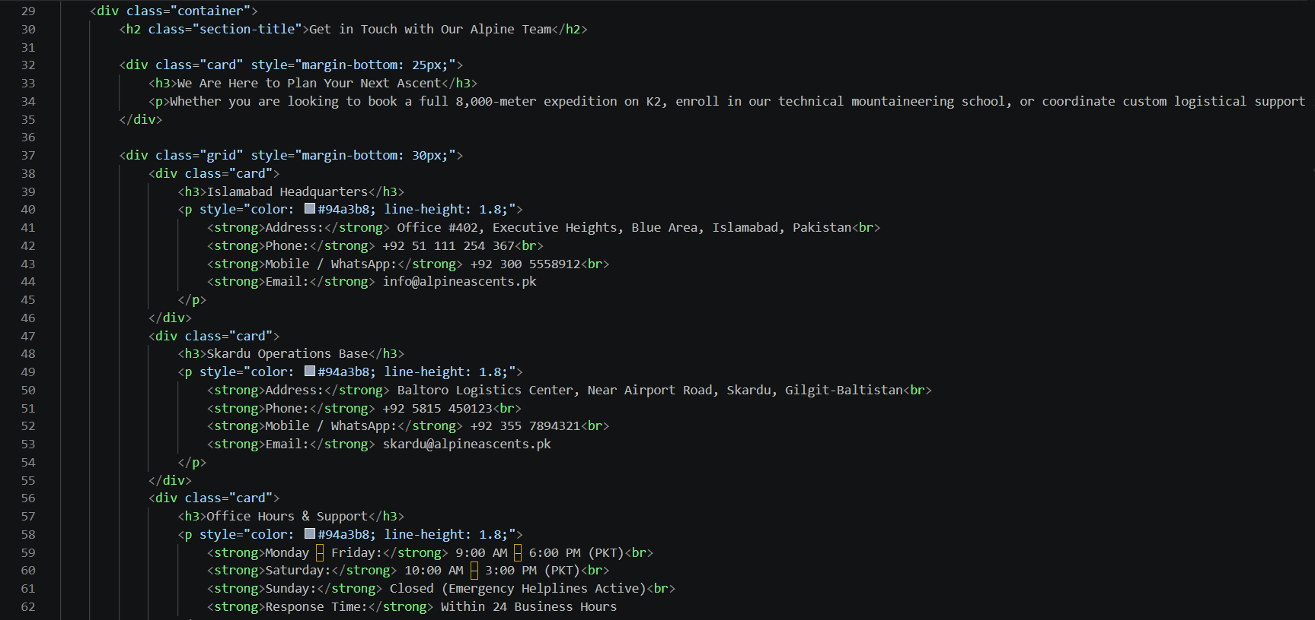
CONTACT Page
Provides users with ways to get in touch for support, inquiries, or feedback.

Slide 9
MEMBERS CONTRIBUTIONS
NAME | WORK1
Burhan Mustafa | Designed UI using HTML, CSS, Java-Script, Jquery, Bootstrap and documentation (full project)

Slide 10
THANK YOU!
BY Alpine Ascents

